Slide 1
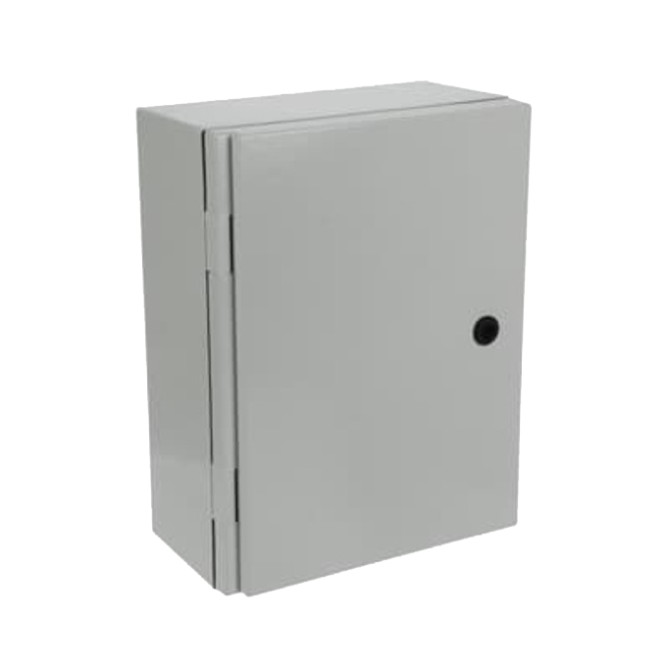
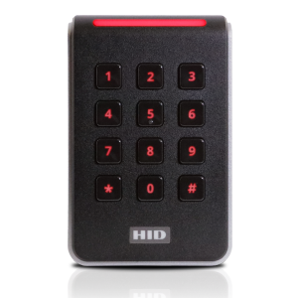
Smart flows
Efficient logistics
PIN-Point - Datasheet
PIN-Point can open 1 barrier
4G/5G router + subscription included
Keypad with numerical keyboard
Water-resistant entry for 3 cables:
Power 230v
Keypad
Barrier (potential free contact)
PIN-Point
Width: | 80mm
Depth: | 24.5mm
Height: | 122.5mm
Keypad
Width: | 310mm
Depth: | 170mm
Height: | 410mm

Slide 2
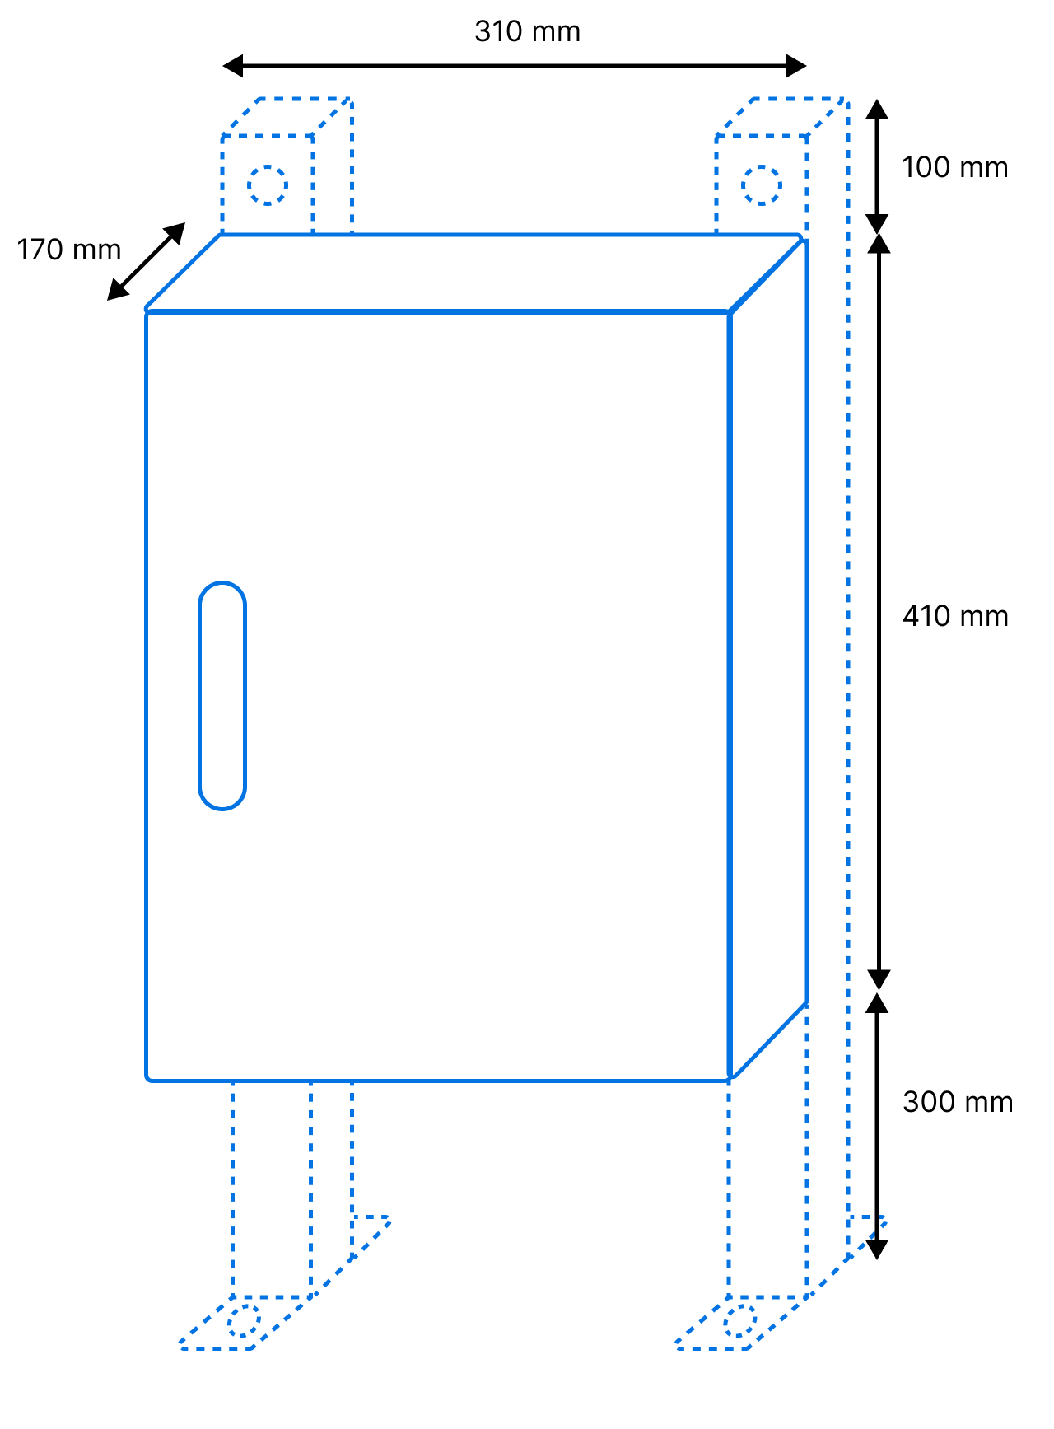
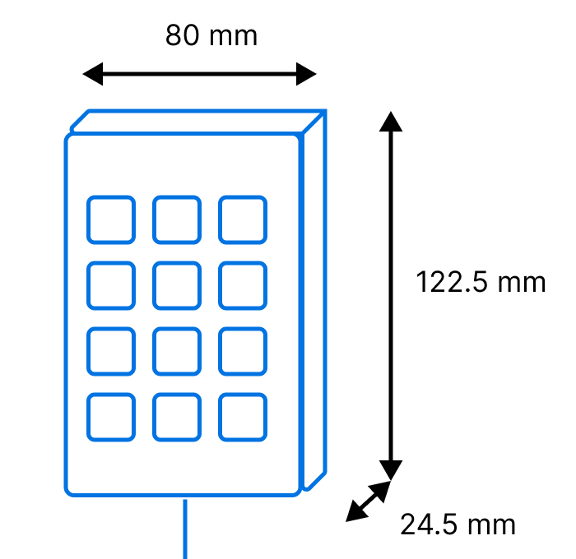
Smart flows
Efficient logistics
PIN-Point - Datasheet
 | PIN-Point enclosure | Keypad
Pre-requisites to be provided on site
Cables | 1 x signal cable to connect the barrier, 1 x Electricity 230v | 1 x STP Fieldbus cable
Surface
Technical specs
Power use | 230v | 12v – powered via PIN-Point
Environmental Rating | Outdoor IP66 – IK10 | Outdoor IP65
Operating Condition | 0°C – 40°C | -35°C – 66°C 0% to 95% non-condensing
General
Materials/casing | Polyester | Polycarbonate
Warranty | 1 year | 1 year

Slide 3
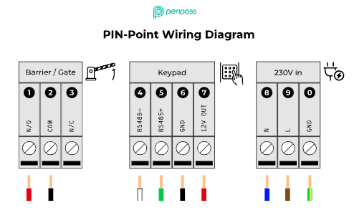
Smart flows
Efficient logistics
PIN-Point datasheet

